Slide 1
Restaurant Kiosk
Logan
Nick
Spencer
Dustin
Dan

Slide 2
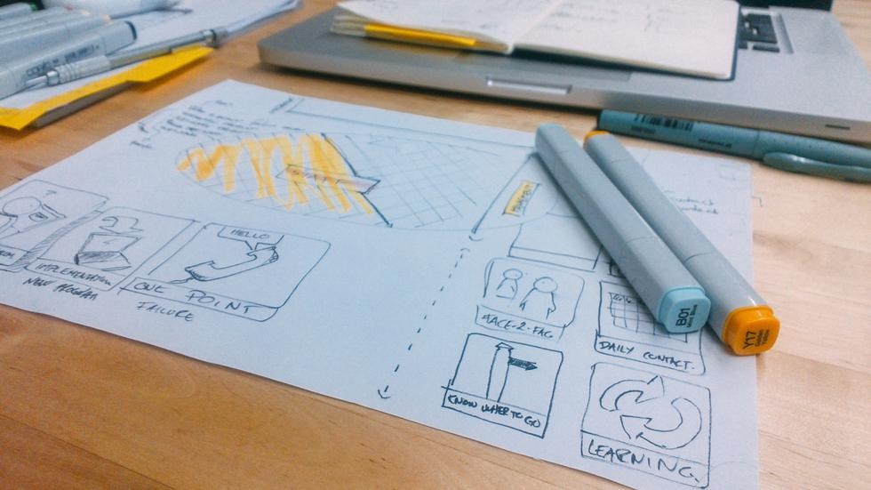
Scenarios
1. Submit an order with a hamburger
2. Add a new item to the restaurant menu
3. Complete an order ticket

Slide 3

Problems
Testing coverage for SQLite
Too large of scope
Menu buttons in Order form

Slide 4
Solutions
SQL Testing
White-Box testing over test cases
Scope
Cut out of scope stories
Buttons
Dynamic generation based on screen ratio

Slide 5

Lessons Learned
Understand the scope of your system
Design the UI before coding
Decompose stories into clearer tasks
We can easily accommodate change, but it still requires extra work.

